Slide 1

Diabetes Feature Importance and Prediction
Team-1 : Kaumudi Vuppala, Vipin Gyanchandani

Slide 2
Introduction
Diabetes is a global epidemic. It is one of the top ten leading causes of death in United States.
According to National Diabetes Information Clearinghouse 2011’s statistics, 25.8 million people (8.3% of overall population of United States) of all ages have diabetes in United States.
Many people are already pre-diabetic and in the verge of risk to type-2 diabetes.

Slide 3
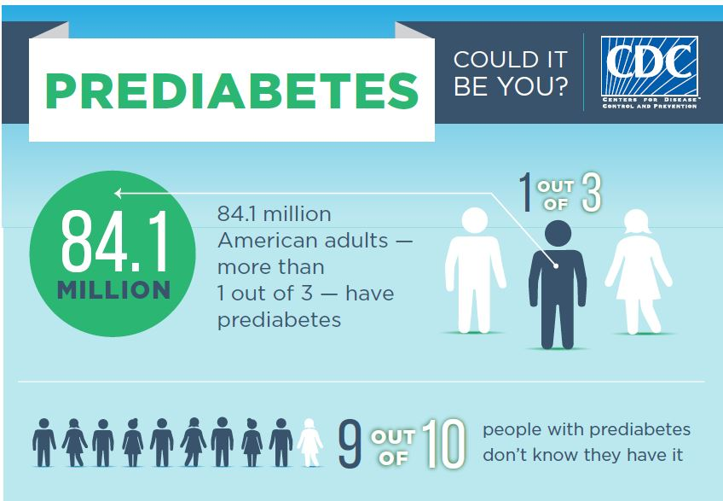

Slide 4
Our problem statement
A lot of research has already been done on type-2 diabetes. The factors that lead to it, and the prediction of it when given some features. In our problem, using National Health and Nutrition Examination Survey (NHANES) data available on Kaggle, we have done a multi class classification with the data by predicting whether a person is,
0- Non Diabetic
1- Pre Diabetic
2- Diabetic
The value we want to bring from this project is, what are the various features that are causing the Diabetes.

Slide 5
Introduction to our Data
National Health and Nutrition Examination Survey(NHANES) data is a survey that has been conducted to assess the health and nutritional status of adults and children in the United States.
It’s a unique data which has survey results and as well as physical examinations.
Description:
Demographic Data- Each person’s personal information such as age, gender, number of people in household, race, etc.
Examinations Data - Various physical examinations done on each survey participant.
Dietary Data - Nutrition intake of the person during the survey period
Laboratory Data- Various laboratory tests administered on person by highly trained medical personnel.
Questionnaire Data - Health related questions that are asked to the person who is being surveyed.

Slide 6
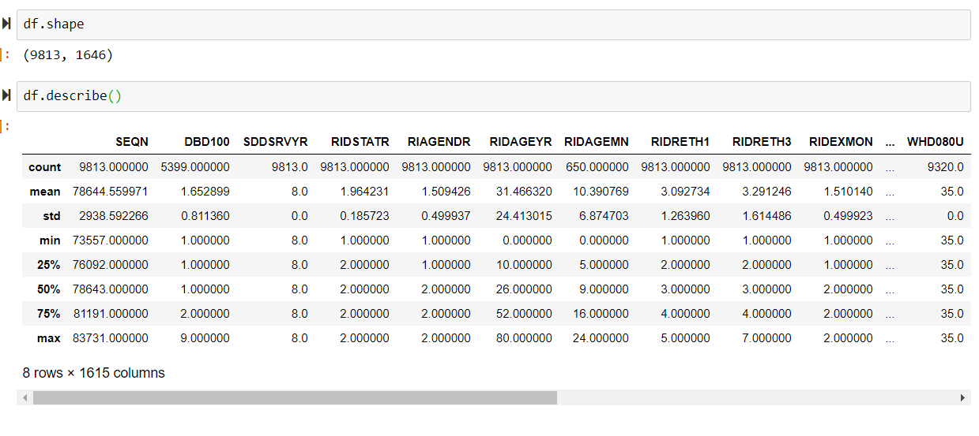
Initial Analysis and EDA on the Data
Merging the data. Cleaning the categorical and continuous features.
Outlier analysis and Imputation of Data

Slide 7
Output Label Prediction
According to WHO and American Diabetes Association, based on the below values, we can tell whether the person is either normoglycemic(i.e no risk of diabetes), prediabetic, and diabetic.
HbA1c: LBXGH
normoglycemic <5.7%, pre-diabetic = 5.7%-6.4%, diabetic>6.4%;
FPG: LBDGLUSI
normoglycemic <100 mg/dl, pre-diabetic = 100-125 mg/dl, diabetic>125 mg/dl;
OGTT: LBDGLTSI
normoglycemic <140 mg/dl(7.7714), prediabetic = 140-200 mg/dl(7.7714-11.102), diabetic >200mg/dl(11.102) (American
Diabetes Association, 2014)
Apart from the above attributes, there are other variables in the dataset which tells whether the person was informed whether he had diabetes before, or prediabetes before. Using these, we are assigning output labels as 0-no diabetes, 1-prediabetes, 2-diabetic

Slide 8
Feature Selection
We have 1646 features overall. With, 60% being categorical, and 40% continuous.
Models Trained for feature selection: Wrapper , filtering, embedded
Lasso with Cross Validation - top 20 features with highest coefficients
Random forests for feature importance - top 20 features in descending order of feature importance
Boruta selector with Random Forests - All the features that were confirmed by the model in 100 iterations
LightGBM with exclusive categorical features list - top 20 features in descending order of feature importance
Final Features selection:
We have taken an intersection of features that we have gotten from Boruta and LightGBM. We have used domain expertise and referred existing research work that has been done in prediabetes prediction to say that the intersection of those two models are the most relevant features.

Slide 9
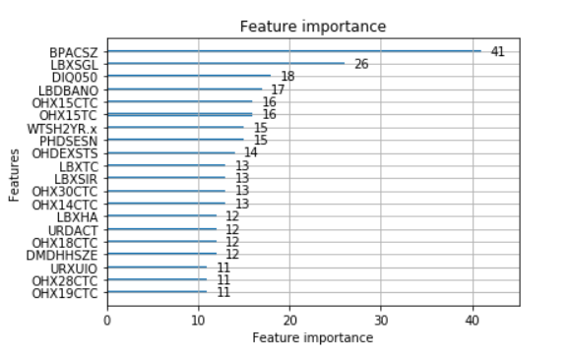

Slide 10
Final selected Features- The VALUE part!!
Some of the most relevant features that we have got from the ML models:
Age
Gender
Race
Whether diabetes has been running in family or not
Oral dental hygiene
BMI
Income to poverty Ratio
Food Security
Number of people in the family i.e family size
Overweight or not
Blood Pressure
Education level
No proven relation to diabetes:
Cuff Size
Grip test status

Slide 11
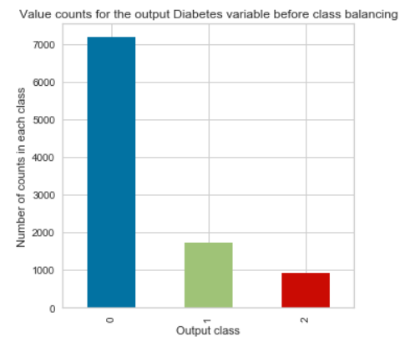
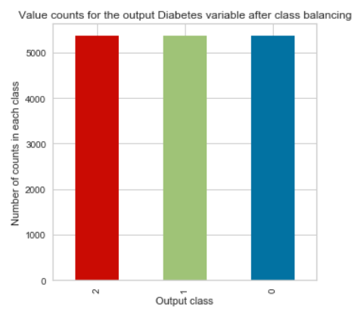
Pre Modelling Part
Data Balancing: Using SMOTE technique

Slide 12
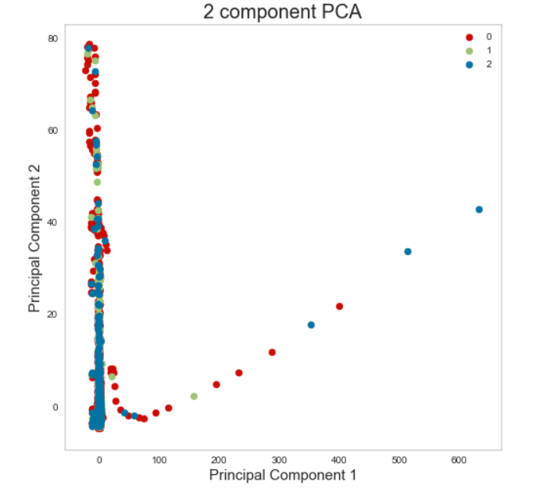
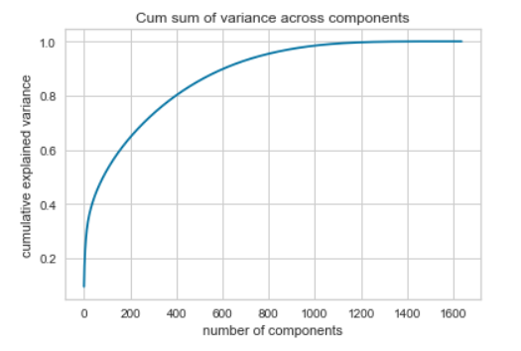
DIMENSIONALITY REDUCTION USING PCA
Before Feature Selection: Very low variance for PCA-2

Slide 13
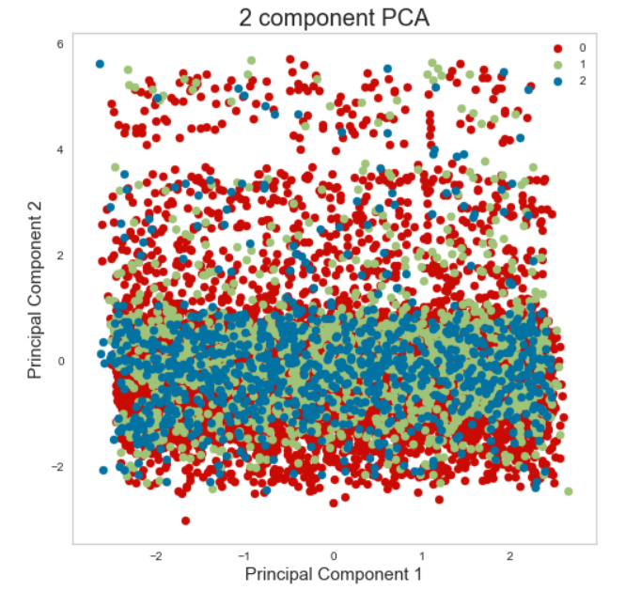
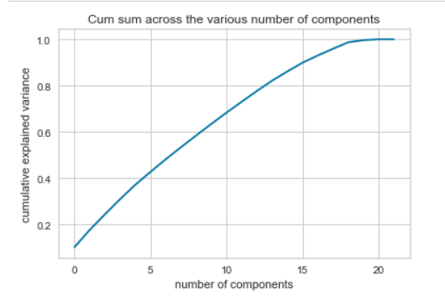
PCA after feature selection

Slide 14
Predictive Modelling
Various models used,
Naive Bayes(Base Classifier)
Decision Trees
SVM
Logistic regression penalized with Lasso
Logistic regression penalized with Ridge
Random Forest
XG Boost Classifier
All models are trained using gridSearchCV to get the best model predictors.
Passed these models to OneVsRestClassifier to get the multi class output predictions.

Slide 15
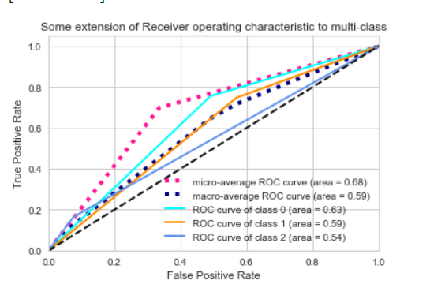
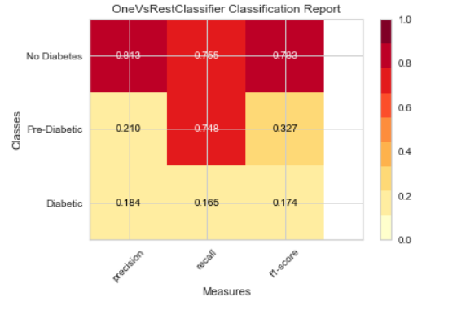
MODEL EVALUATION- Area under ROC curve, Precision, recall, f1-scores for each class

Slide 16
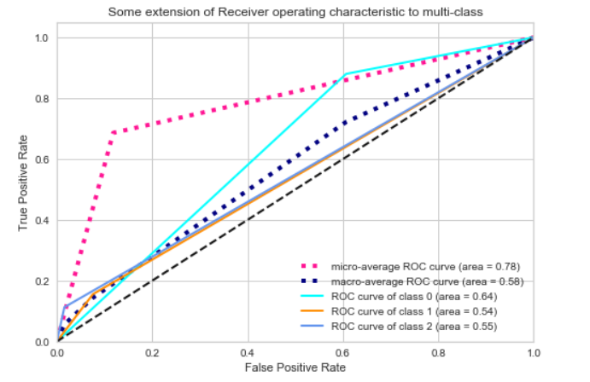
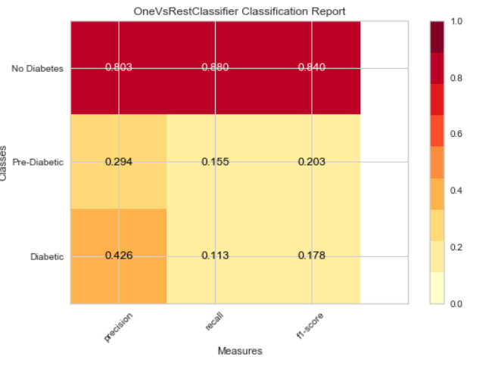
BEST MODEL - XGBoost Classifier and Random forests
Area under the curve- 80%
Best precision, recall scores across all models for each class

Slide 17
Final Remarks
By knowing the features that cause the PreDiabetes and Diabetes, we can take the preventive measures to curb it.
With this study, apart from how age, weight, income , we understood that maintaining oral dental hygiene is one of the important factors that contributing to the cause diabetes and changes in glucose levels.
Now a days, especially in America, everyone are at risk of prediabetes.
We want to suggest everyone that, by changing very small things in lifestyle, diet, and working out regularly, prediabetes can be eradicated and diabetes can be prevented.
Keep calm and curb Diabetes!!!

Slide 18


